Slide 1
Dynamic Interest Rates Project Proposal
Dynamic Interest Scaling for FDs and Home Loans

Slide 2



Our team
Jenna Doe
Susan Bones
Timmy Jimmy
Here you can talk a bit about this person
Here you can talk a bit about this person
Here you can talk a bit about this person

Slide 3
Table of contents
01
04
02
05
03
06
About the project
Budget
Here you could describe the topic of the section
Here you could describe the topic of the section
Market Sizing
Project stages
Here you could describe the topic of the section
Here you could describe the topic of the section
Proposed Solutions
Conclusion
Here you could describe the topic of the section
Here you could describe the topic of the section

Slide 4
01
About the project
Project Overview and Business use cases

Slide 5

Project Overview
Dynamic Interest Rate – Interest rates should be dynamically determined instead of being fixed.
AI-Powered Rate Suggestion – Use Gen AI to suggest optimal interest rates for both products.
Enhanced Decision-Making – The System should help banks improve competitiveness and customer satisfaction by offering optimized rates.
Personalized Recommendations – Rates should be adjusted based on customer profile, credit score, and other parameters.

Slide 6
What we are working on
Fixed Deposits
Home Loans
Risk-Management
Improve Loan Approval Rates
Enhance Profitability
Optimized Interest Rates Customer Retention Competitive Edge

Slide 7

Now
Build a Dynamic Interest Rate management system focused on Indian Market.

Slide 8

Future
Expand the system to others locations in the world and other related Industries.

Slide 9
02
Market Sizing

Slide 10
Market segmentation
Banks
Fintech
Public & Private Sector Banks, Regional & Cooperative Banks, Neobanks & Digital Banks
P2P Lending Platforms, AI-Powered Loan Aggregators
NBFCs
Govt. Bodies
HFCs, Mortgage Lenders & Housing Finance Firms, Investment & Deposit-Based NBFCs
Central Banks & Policy Makers, Public Sector Lending Institutions

Slide 11
Customer segmentation
Demographic
Behavioral
Age Group, Income Level, Employment Type, Marital Status
Investment Preferences, Loan Repayment Behaviour, Loan Tenure Preferences
Geographic
Psychographic
Urban, Semi-Urban, Rural Customers
Risk Appetite (Averse, Neutral, Tolerant), Tech-Savvy & Traditional Customers

Slide 12
$ 385.14 B
By 2033, the valuation of India Housing Finance Market is anticipated to reach $ 2,669.39 Billion.
@ customermarketinsights

Slide 13
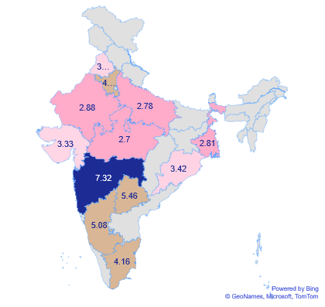
Investments - 2023
Low
Avg. Fixed Deposit Investment is 2.7 – 3.4 Lakhs
Medium
Avg. Fixed Deposit Investment is
3.4 – 5.08 Lakhs
High
Avg. Fixed Deposit Investment is
5.08 – 7.32 Lakhs

Slide 14
Interest Rates
6.5%
Highest
6.5% is the Highest Interest Rate in past 5 years.
4.0%
Lowest
4.0% is the Lowest Interest Rate in past 5 years.
6.5%
Current
6.5% is the Current Interest Rate in 2025.

Slide 15
03
Proposed Solutions

Slide 16
Proposed Solutions
Mathematical
Gen AI
ML
Rule-Based Framework
Completely AI-Driven
Solution
Supervised Learning
Model

Slide 17
Mathematical Approach
This method involves a structured, rule-based framework where predefined adjustments are applied to the base interest rate based on specific credit-related parameters.
The decision rules are structured with the assistance of Generative AI, while the final rate modifications are manually determined.
Pros
Simple, structured, and easy to interpret.
Transparent decision-making process.
Does not require large datasets for training.
Predictable and consistent results
Cons
Manual intervention needed for updating rate adjustments.
Limited ability to capture complex, nonlinear patterns in data.

Slide 18
Gen - AI Approach
In this model, a foundational interest rate and key influencing parameters are embedded into an AI prompt.
The AI then analyzes these inputs and generates an optimal interest rate dynamically, eliminating the need for manual adjustments.
Pros
Dynamic rate generation based on real-time input conditions.
Reduces manual intervention in decision-making.
Can incorporate complex financial scenarios and reasoning.
Cons
Results may lack consistency across multiple queries.
May not always align with regulatory compliance.

Slide 19
Machine Learning Approach
A supervised learning model is trained using historical financial data, incorporating multiple parameters such as credit score, income, loan-to-value ratio, and past repayment behavior.
The trained model predicts the final interest rate based on data-driven patterns, enabling an adaptive and automated decision-making process.
Pros
Data-driven and continuously improves with new financial data.
Captures intricate patterns and trends in financial behavior.
Minimizes manual decision-making and enhances automation.
Cons
Requires a large and high-quality dataset for training.
Needs continuous monitoring and retraining for optimal performance.

Slide 20
Deployment
Web App
Desktop App
Mobile App
Frontend
React.js
Backend
Spring Boot
Fast API
Frontend
Electron.js
Backend
Spring Boot
Fast API
Frontend
Electron.js
Backend
Spring Boot
Fast API

Slide 21
04
Budget

Slide 22
Major requirements
Storage
Security
Database (SQL, NoSQL), Data Warehouse
Oauth, Azure Key Vault
APIs
Scaling
Banking APIs, OpenAI API,
Bing Search API
Manual or Event Based Scaling
Web Servers
Backup
Azure App Service
Cold Storage, Backup Servers

Slide 23
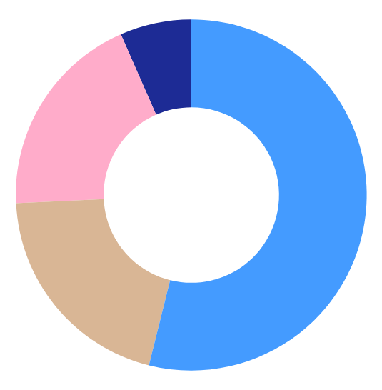
Budget
10$
7 %
8,000$
Development
19 %
Deployment
Venus has a beautiful name
54 %
It’s the biggest planet
2,000$
20 %
2,000$
Testing
Marketing
It’s the planet where we live on!
It’s the the smallest planet

Slide 24
05
Project Stages

Slide 25
Pilot Testing
Partner with a regional bank to deploy the MVP. Gather feedback to refine risk models and forecasting algorithms.
Market Launch:
Roll out the full solution with a targeted go-to-market strategy. Support banks in transitioning from static to dynamic pricing.
02
04
01
03
05
Research & Development
Validate model assumptions with historical data. Build a minimum viable product (MVP) of the dynamic pricing engine.
Iteration and Scaling
Integrate advanced analytics and user-friendly dashboards. Enhance API integration to support multi-product functionality.
Expansion & Diversification:
Extend the solution’s capabilities to additional financial products. Continuously update the system with real-time data feeds and regulatory insights.

Slide 26
Timeline
UI/UX
Testing
It’s the biggest planet in the Solar System
Despite being red, Mars is a cold place
Feb
April
May
June
Backend
Security
Venus is the second planet from the Sun
Neptune is the farthest planet from the Sun

Slide 27
06
Conclusion

Slide 28
Project Goals
Dynamic Rates
Competitive Rates
Transparency
Risk Management
Dynamic Interest Rate Calculation System
Maintain a balance between competitive market rates and profitability
Enable transparency in rate calculation to build customer trust.
Mitigate risks associated with high-risk borrowers while ensuring fair interest rates for all customers.

Slide 29


